Slide 1

DR. D.Y.PATIL INSTITUTE OF ENGINEERING
AND TECHNOLOGY, AMBI, PUNE.
[2022-23]
DEPARTMENT OF
MECHANICAL ENGINEERING
PROJECT GUIDE
PROF. JAYASHREE.P.ZOPE
PROJECT COORDINATOR HOD MECH DEPARTMENT
PROF. A.H. RAUT DR. K.C. MORE

Slide 2
TITLE
PERFORMANCE AND ANAIYSIS OF PARABOLIC TROUGH COLLECTOR USING PHASE CHANGE MATERIAL
PRESENTED BY
MR. ANAND PRADIP SHENDE
MR. ADITYA NARESH AJMIRE
MR. RUSHIKESH NARAYAN PATIL
MR. NILESH SHARADCHANDRA GHOGARE

Slide 3
CONTENTS
INTRODUCTION
LITERATURE REVIEW
METHODOLOGY
PROJECT PLAN
LAYOUT OF PROJECT
BASIC COMPONENTS
PROCESS LIST
COST ESTIMATION
REFRENCE

Slide 4
INTRODUCTION
Energy requirement is increasing day-by-day for all of us. Though the major demand comes in the form of electrical energy for domestic as well as the industrial sector, some of this demand can be reduced by appropriately utilizing ther- mal energy available via solar radiation. Phase change mate- rial (commonly known as PCM), which has become an attrac- tive means to store thermal energy, has a wide range of applications in today's world. This article explains the PCM- based technology, its principle and its numerous applications in everyday life.
After the 20th century, many countries have focused on renewable sources of energy for thermal and electricity production. The general objective is to reduce the environmental impact due to the increased use of fossil fuels. The dominant renewable energy source is solar energy, and many technologies were developed to exploit this resource, such as thermal plants and photovoltaics.
Thus, the use of PTC systems is the most appropriate for a wide range of applications in industries and can contribute to their thermal energy production, that could have had significant economic, environmental, and social impacts. Particularly, the industry where such a system is installed, could be independent of the fluctuation of the fuel costs and this could stabilize the final product prices produced by that industry at a lower level. The energy safety that results from the lower dependence of the fuel suppliers is the most significant motivation for this kind of investment. The application of these systems, in addition to the short payback times offered for various industries, could also help to mitigate the global climate change phenomena, as less fossil fuel consumption could lead to less environmental pollution, and thus they help to achieve a healthier living environment.

Slide 5
LITERATURE REVIEW
Yogesh nayak(2010):-His main area of research activity is Power System, Renewable Energy and Heat Transfer
Performance prediction of absorber tube of Parabolic Trough Concentrator with the enhancement of heat transfer by varying the width of twisted tape inserts. Mathematical expressions have developed for the model to simulate the results for prediction of performance using C++ program. On the basis of simulated results, variation of Nusselt number, Friction factor and overall enhancement with Reynolds number and twist ratio for different values of the width of twist tape inserts have been studied.
Dr. U. K. Sinha(2010):- his research interests are in the area is Renewable Energy
India is the fastest growing country, and Indian industries are growing faster than other developing countries to support Make in India initiative. With the technological advancement, every Indians are using multiple gadgets, applications to ensure their comfortable lifestyles resulted per capita consumption of electrical energy in India is increasing day by day. To meet the industrial, commercial, and residential power demand, India is increasing power generation capacity on every year, but the major challenges to generate the conventional power are sharp depletion of fossil fuels as country like India primarily depends on fossil fuels for power generation.
Dr. P. Kumar(2011):-his research interests are in the areas of Thermal Engineering, Refrigeration & Air Conditioning
Performance prediction of STPTCS has been studied by enhancement of heat transfer rate using nanofluid, plain twisted tape and nail twisted tape inserts. Nanofluid and twisted tape inserts based STPTCS are commonly used in the area as such as industries, heating and cooling for buildings, thermal power plants, solar cooker, automobiles etc. This paper provides enhancement and performance prediction in heat transfer in absorber tube of concentrator using nanofluid and twisted tape inserts.

Slide 6
METHODOLOGY
General survey
Material selection
List of components
Design of solar collector
Process chart
Cost Estimation
Fabrication of Parabolic trough collector
Testing & analysis

Slide 7
PROJECT PLAN
Work activity | Jul | Aug | Sept | Oct | Nov | Dec | Jan | Feb | Mar | Apr | May
Problem definition
Literature review
Study of existing system
Design of project
Fabrication
Experimentation
Verification of experimentation & design
Report writing
Final Presentation

Slide 8
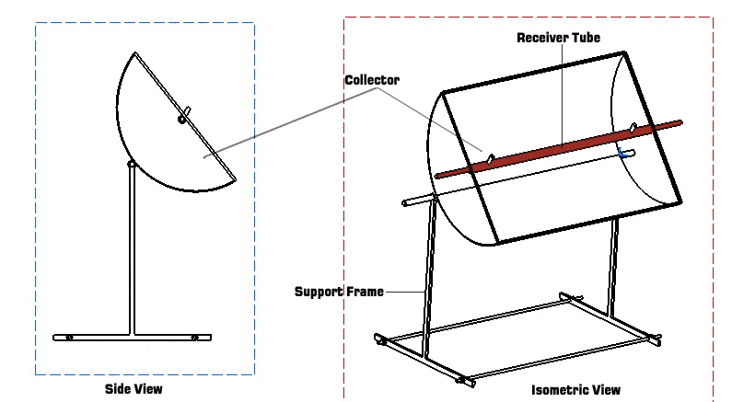
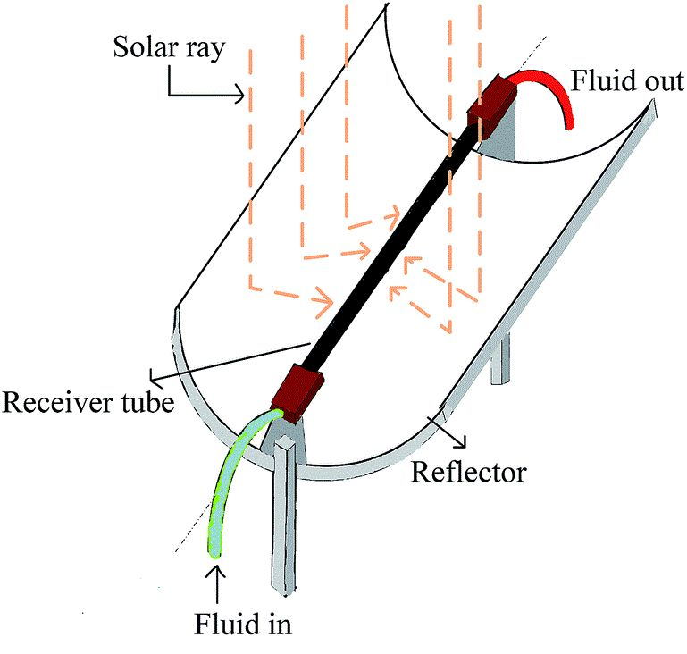
LAYOUT OF PROJECT

Slide 9
BASIC COMPONENTS
Parabolic through collector : A parabolic trough is a type of solar thermal collector that is straight in one dimension and curved as a parabola in the other two, lined with a polished metal mirror. The sunlight which enters the mirror parallel to its plane of symmetry is focused along the focal line, where objects are positioned that are intended to be heated. In a solar cooker, for example, food is placed at the focal line of a trough, which is cooked when the trough is aimed so the Sun is in its plane of symmetry.
Receiver tube:The Heat Collecting Element is a concentric tube in which outer tube is Copper tube of diameter 1.4inch(29mm) and inner tube is copper tube of diameter 0.5 inch(15mm).Outer tube has given inlet port and outlet port on its surface which are used for feeding and discharging of PCM().Inner tube having two openings for water flow.
Pump: Since we will be using a forced circulation, we need to incorporate a pump to maintain flow in the system.
Valves: Valves will be used to isolate the daytime water line and night time water line, with each other.
PCM Heat Exchanger: PCM heat exchanger is the most important component of our system and is the system which is under study.
Phase Change Material: PCM will be incorporated in the heat exchanger for thermal energy storage. This will be discussed in detail later. PCM is the backbone of this project.

Slide 10
PROCESS LIST
Part | Process/Machining | Time(Min) | Cost(Rs./min) | Total Cost(Rs.)
Outer Copper Tube(inlet & outlet ports) | Flaring | 30 | 10 | 300/-
Copper To Copper joint | Brazing | 30 | 08 | 2400/-
Trough Collector to iron frame | Arc Welding | 45 | 06 | 270/-

Slide 11
COST ESTIMATION
Material | Bought/Made | Quantity | Cost (in Rs.)
AluminiumSheet |  | (24gauge thickness) | 800
Reflecting Mirrors |  | (10 dozen) | 950
Copper tube |  | 1 | 4000
Bearing |  | 2 | 210
Flow Control valves |  | 2 | 280
Thermocouples |  | 2 | 300
PCM() |  | 2 kg | 450
Temperature indicator |  | 1 | 1450
Chain-Sprocket |  | 1 | 350
Support (Iron Frame) |  | - | 500
Other Accessories |  | - | 980
 |  |  | Total= 10,270

Slide 12
REFERENCE
Abdel Illah Nabil Korti, Fatima Zohra Tlemsani ''Experimental investigation of latent heat storage in a coil in PCM storage unit''
H.L. Zhang, J. Baeyens , J. Degrève , G. Cáceres , R. Segal , F. Pitié ''Latent heat storage with tubular-encapsulated phase change materials''(PCMs).
Donald Q. Kern “Process heat Transfer “ ,Tata McGraw Hill Edition 1997
Stefan Hubner, Markus Eck, Christoph Stiller, Markus Seitz''Techno- economic heat transfer optimization of large scale latent heat energy storage systems in solar thermal power plants'' (…2016)
Ayman Bayomy , Stephen Davies & Ziad saghir “Domestic hot water storage tank utilizing phase change material"(…6 June 2019)
Bruno Ca´rdenas , Noel Leo´n , John Pye , He´ctor D. Garcıa ''Design and modeling of a high
temperature solar thermal energy storage unit based on molten soda lime silica glass'' (…2016)

Slide 13
THANK YOU

